Slide 1
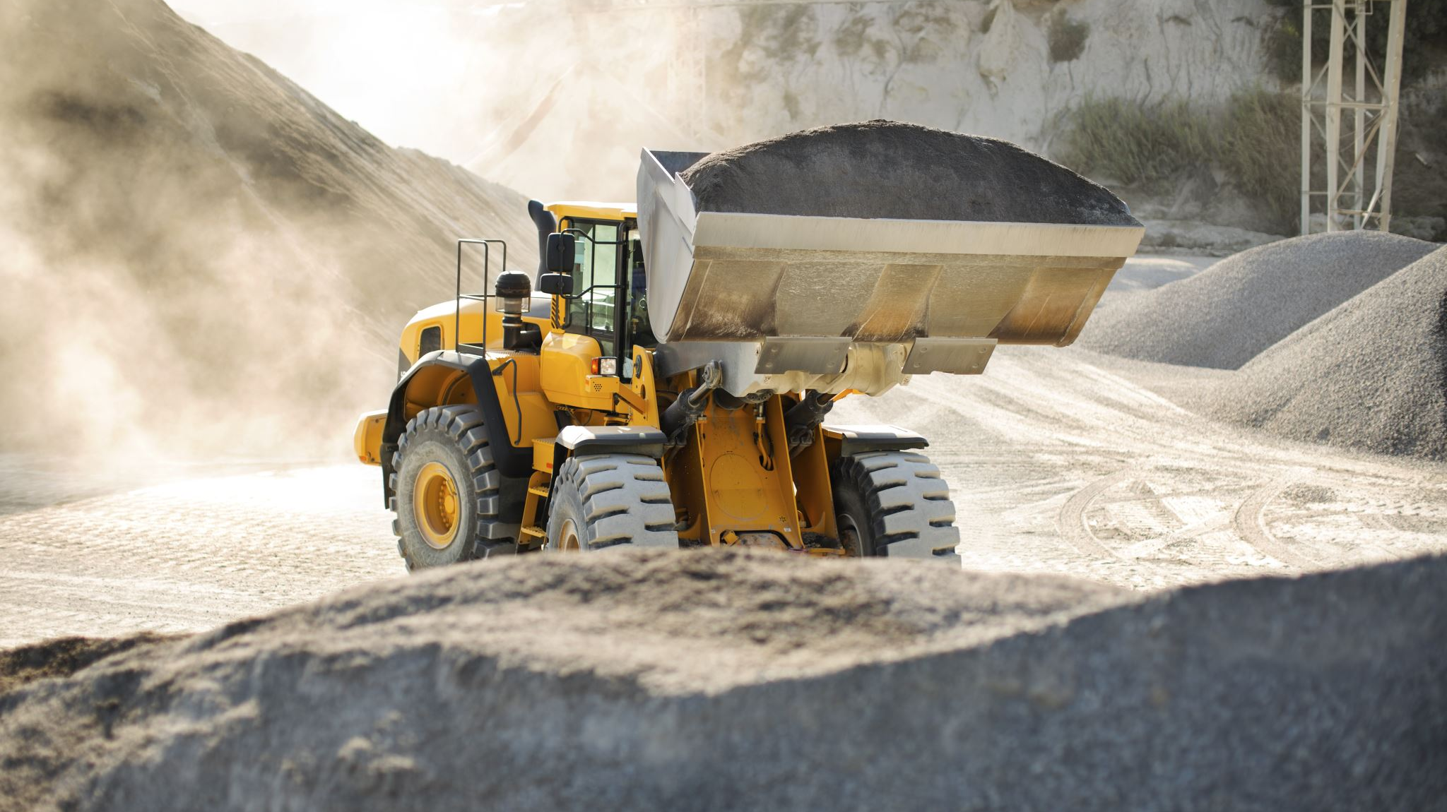
ZHAGARAM
Haulage Operation Of Dumpers During The Absence Of Operators In The Mines

Slide 2
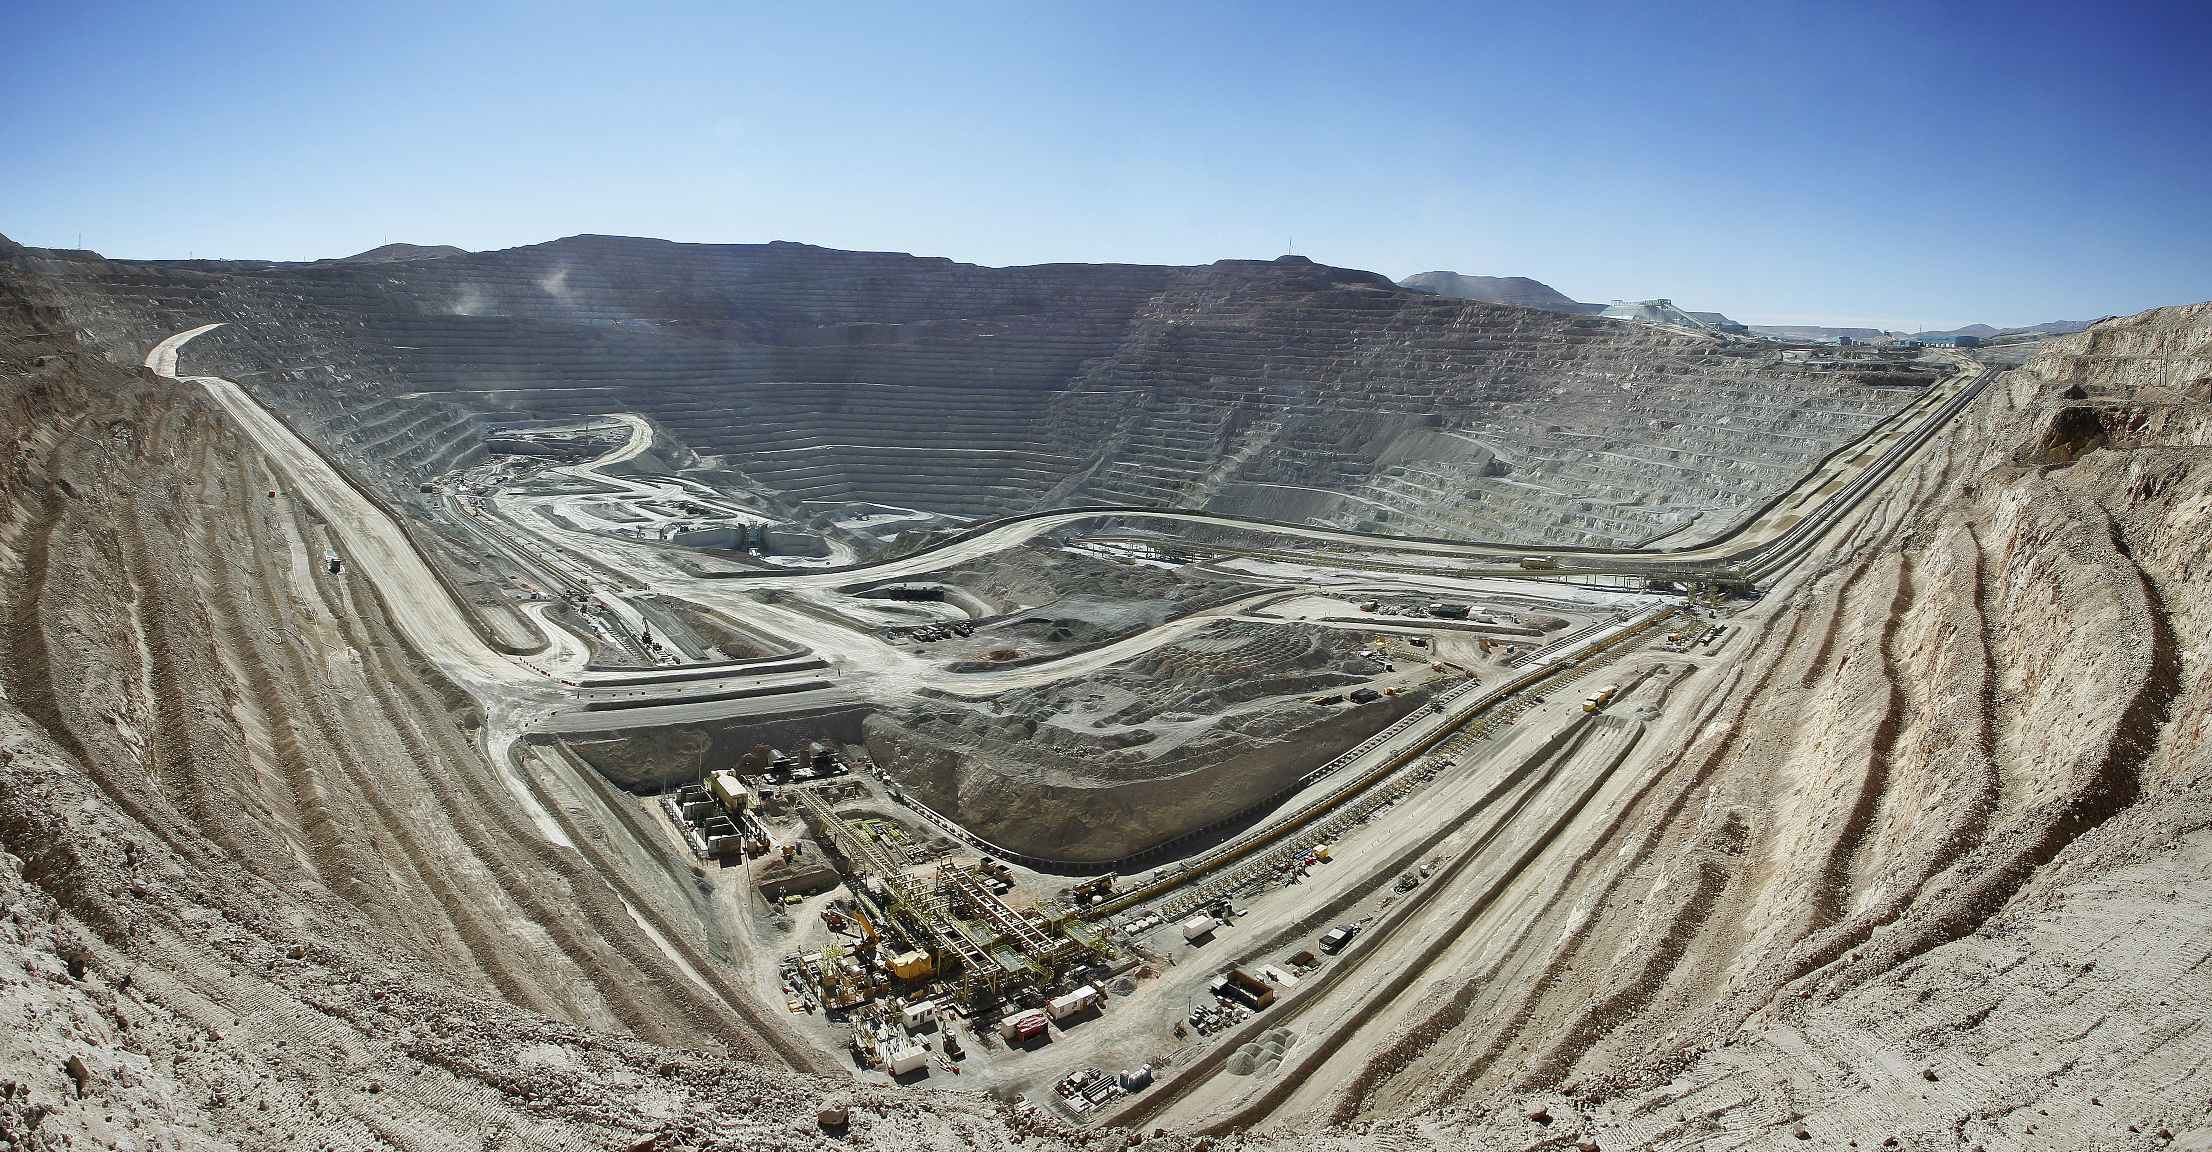
PROBLEM STATEMENT
Managing Disruptions in​ Haulage Operations
Road blockades & strikes by locals.
Haulage operations come to a complete halt.
Additional Challenge
Haulage is aligned with the available workforce.
Need for Adaptation
Scenario
Absence of dumper operators.
Consequence
Manage workforce availability.
Impact

Slide 3
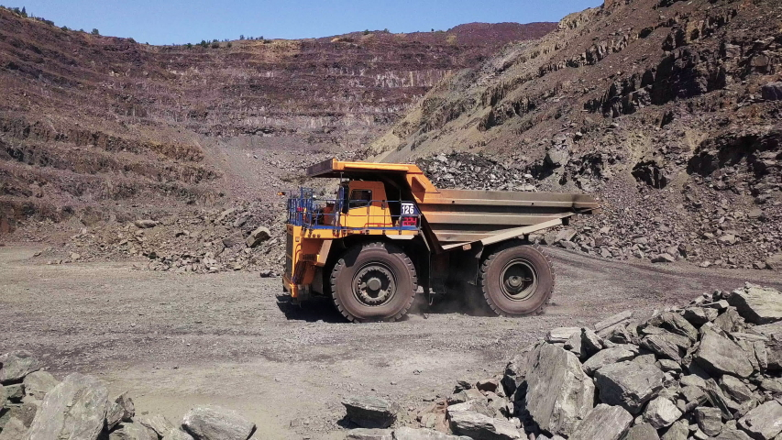
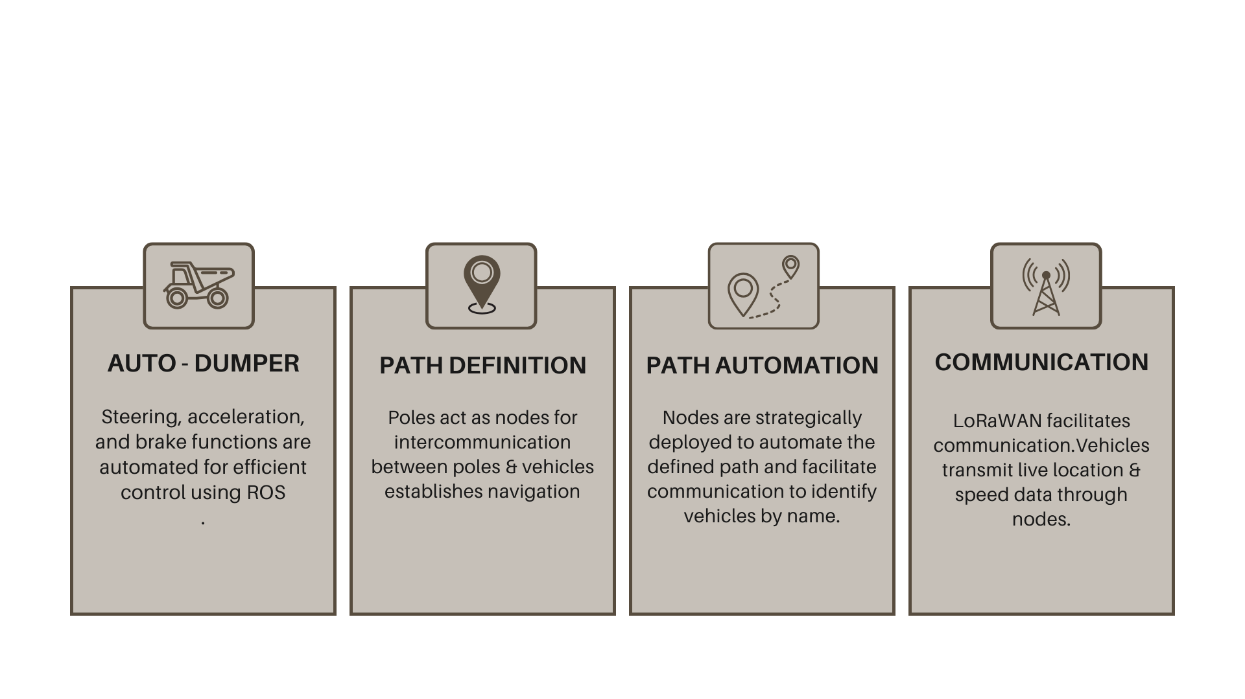
PROPOSED SOLUTION ​
AutoHaul: ROS & LoRaWAN / IoT Integration for Efficient Haulage

Slide 4
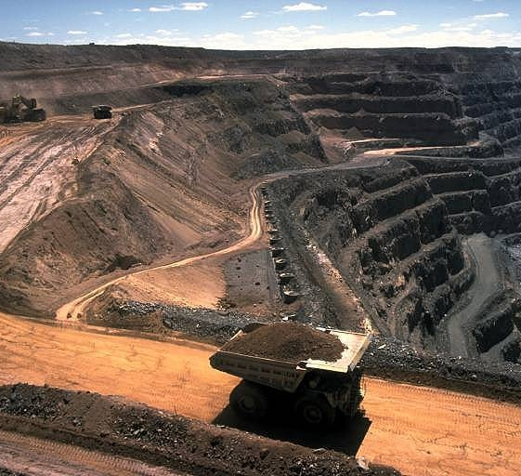
EXISTING SOLUTION
Dumper system dominates mining costs.
50-60% allocated to truck haulage.
Major financial impact on companies.
Emphasizes critical role in mining investment.

Slide 5
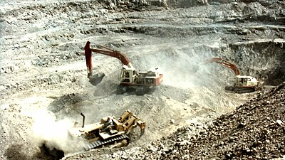
SURFACE MINES
(Underground mine to Surface mine ratio is 20:80)
METALLIC MINES
NON-METALLIC MINES
Coal
Limestone
Zinc
Silicon
Iron
Silver
Gold
Diamond
Gypsum
Mica

Slide 6
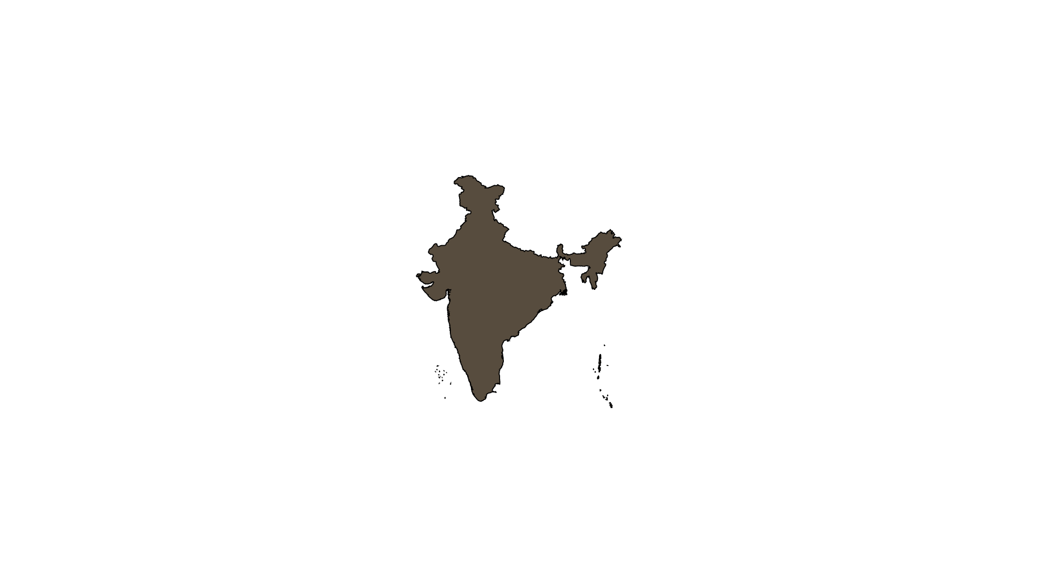
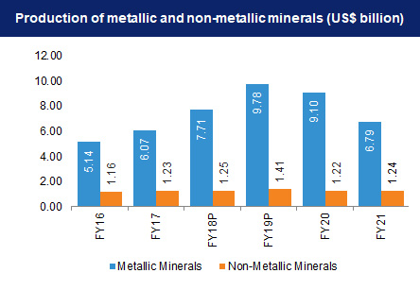
STATISTICS
By the GDP of the total industrial sector,
1) Contributes around 10% to11%
2) Mining done on small scale contributes 6%
Provides job opportunities to around 700,000 individuals.

Slide 7
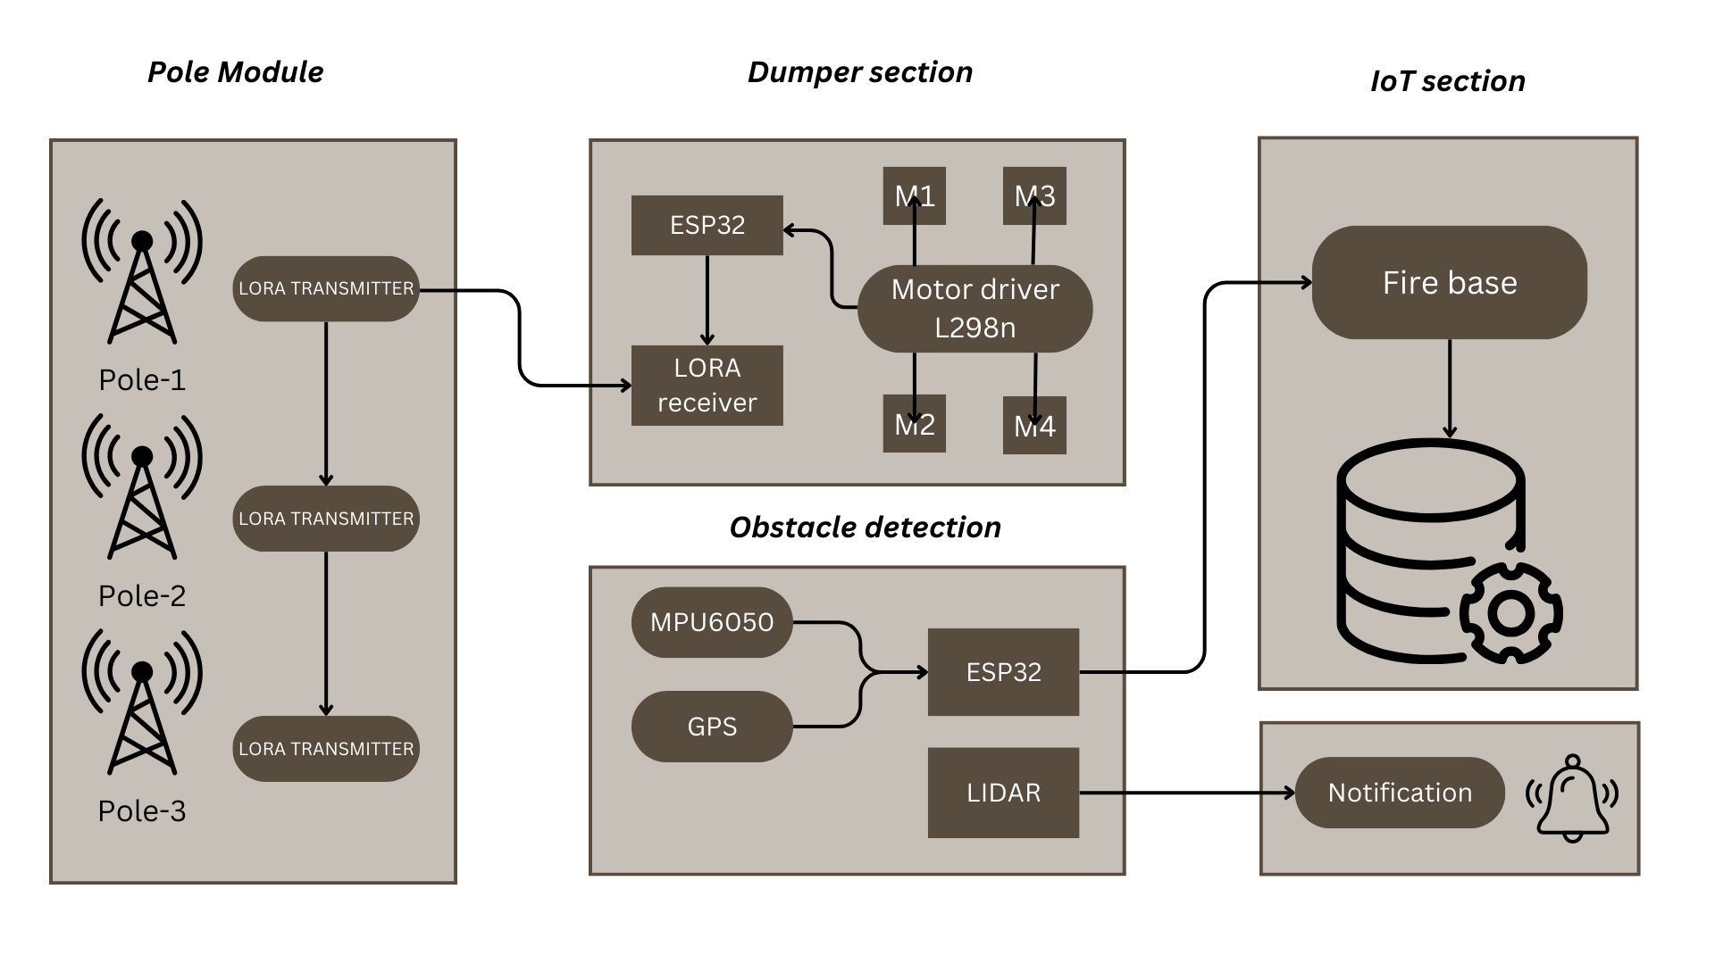
BLOCK DIAGRAM

Slide 8
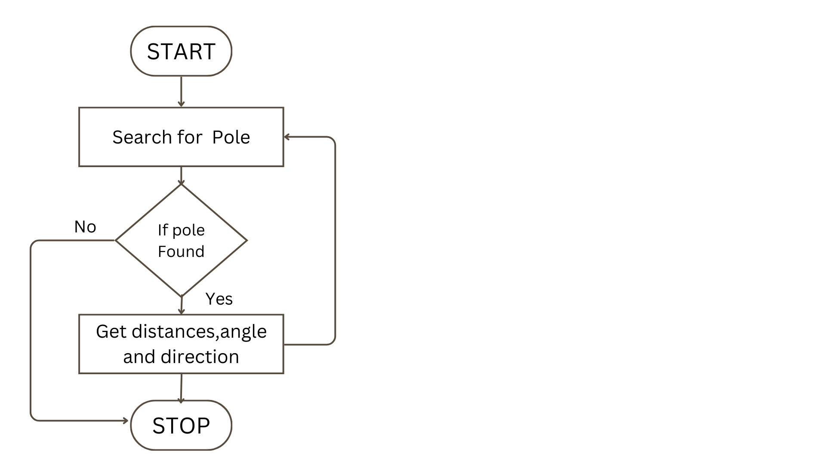
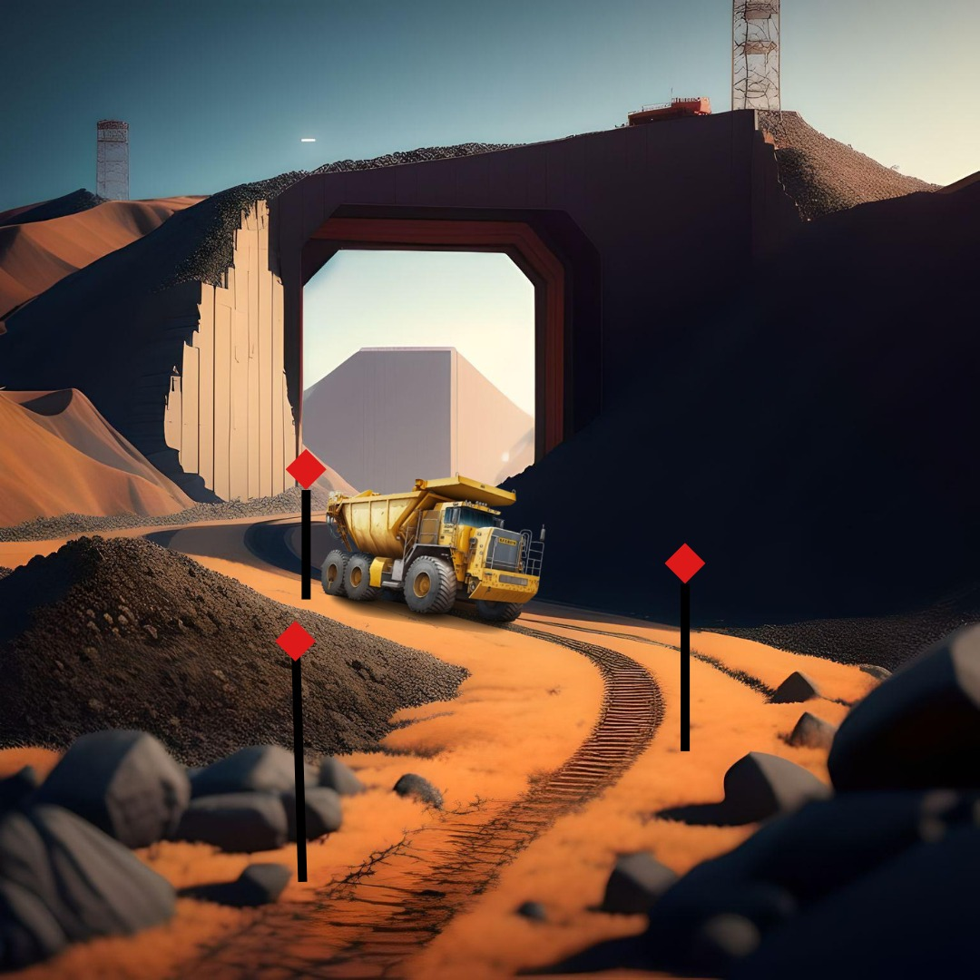
FLOW CHART
3D IMAGE
Vehicle Module

Slide 9



SDG RELAVANCE
Industry, Innovation, and Infrastructure
Justification: Promoting innovation and infrastructure development in the mining sector, improving efficiency and reducing disruptions caused by external factors
Decent Work and Economic Growth
Justification: Enhancing economic growth and providing more stable employment opportunities in the mining industry.
Sustainable Cities and Communities
Justification: Reduces disruptions in transportation, contributing to more sustainable and resilient communities by ensuring smooth material flow, especially in mining regions.

Slide 10
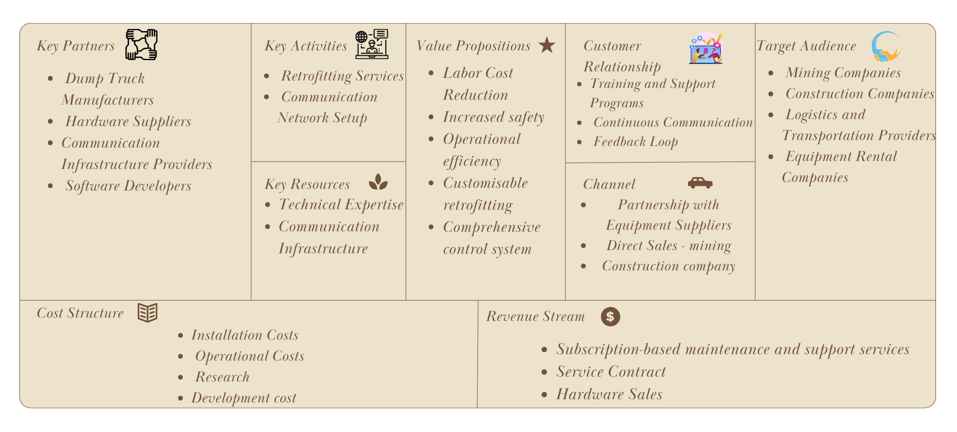
BUSINESS MODEL

Slide 11
COMPONENTS REQUIRED
Vehicle
Pole
Software required
ESP 32
L298 Motor
Lora and Antenna
Motor-12V DC
Ultrasonic sensor
Neo 6M GPS
ADXL 335 accelerometer
Arduino uno
Lora
Antenna
Arduino IDE
ROS
Firebase
HTML, CSS
SMS Chef
Pushing box
Simulink

Slide 12
THANK YOU

